Slide 1
DECODER
& ENCODER

Slide 2
DECODER
A decoder is a combinational circuit.
A decoder accepts a set of inputs that represents a binary number and activates only that output corresponding to the input number. All other outputs remain inactive.
Fig. 1 shows the block diagram of decoder with ‘N’ inputs and ‘2^{N} outputs.
There are 2^{N} possible input combinations, for each of these input combination only one output will be HIGH (active) all other outputs are LOW
Some decoder have one or more ENABLE (E) inputs that are used to control the operation of decoder.

Slide 3
BLOCK DIAGRAM OF DECODER
DECODER
‘2^{N} outputs
‘N’ inputs

Slide 4

2 to 4 Line Decoder:
Block diagram of 2 to 4 decoder is shown in fig. 2
A and B are the inputs. ( No. of inputs =2)
No. of possible input combinations: 2²=4
No. of Outputs : 2²=4, they are indicated by D₀, D₁, D₂ and D₃
From the Truth Table it is clear that each output is “1” for only specific combination of inputs.
D D
TRUTH TABLE
A
0
INPUTS |  | OUTPUTS
A | B | D₀ | D₁ | D₂ | D₃
0 | 0 | 1 | 0 | 0 | 0
0 | 1 | 0 | 1 | 0 | 0
1 | 0 | 0 | 0 | 1 | 0
1 | 1 | 0 | 0 | 0 | 1
2 X 4
Decoder
1
B
D₂
D
Outputs
3
Inputs
Fig. 2

Slide 5
D₁ = A B D₃ = AB
BOOLEAN EXPRESSION:
From Truth Table
D₀ = A B
D₂ = A B
LOGIC DIAGRAM:
A B
A
B
D₀ = A B
D₁ = A B D₂ = A B D₃ = A B
Fig. 3

Slide 6
3 to 8 Line Decoder:
Block diagram of 3 to 8 decoder is shown in fig. 4
A , B and C are the inputs. ( No. of inputs =3)
No. of possible input combinations: 2³=8
No. of Outputs : 2³=8, they are indicated by D₀ to D₇
From the Truth Table it is clear that each output is “1” for only specific combination of inputs.
A
B C
3 X 8
Decoder
. D₀
.
.
.
D₇
Outputs
Inputs
Fig. 4

Slide 7
TRUTH TABLE FOR 3 X 8 DECODER:
INPUTS |  |  | OUTPUTS
A | B | C | D0 | D1 | D2 | D3 | D4 | D5 | D6 | D7
0 | 0 | 0 | 1 | 0 | 0 | 0 | 0 | 0 | 0 | 0 | D₀ = A B C
0 | 0 | 1 | 0 | 1 | 0 | 0 | 0 | 0 | 0 | 0 | D₁ = A B C
0 | 1 | 0 | 0 | 0 | 1 | 0 | 0 | 0 | 0 | 0 | D₂ = A B C
0 | 1 | 1 | 0 | 0 | 0 | 1 | 0 | 0 | 0 | 0 | D₃ = A B C
1 | 0 | 0 | 0 | 0 | 0 | 0 | 1 | 0 | 0 | 0 | D₄ = A B C
1 | 0 | 1 | 0 | 0 | 0 | 0 | 0 | 1 | 0 | 0 | D₅ = A B C
1 | 1 | 0 | 0 | 0 | 0 | 0 | 0 | 0 | 1 | 0 | D₆ = A B C
1 | 1 | 1 | 0 | 0 | 0 | 0 | 0 | 0 | 0 | 1 | D₇ = A B C

Slide 8
LOGIC DIAGRAM OF 3 X 8 DECODER:
INPUTS
A B C
A B
C
D₀ = A B C
D₁ = A B C
D₂ = A B C
D₃ = A B C
D₄ = A B C D₅ = A B C D₆ = A B C D₇ = A B C
OUTPUTS
Fig. 5

Slide 9
EXPANSION OF DECODERS:
The number of lower order Decoder for implementing higher order Decoder can be find as
No. of lower order required = m₂/m₁
Where,
m₁=No. of Outputs of lower order Decoder m₂=No. of Outputs of higher order Decoder

Slide 10
3 x 8 Decoder From 2 x 4 Decoder:
2 x 4 Decoder
D₀ D₁ D₂ D₃
X
Y
INPUT
E
OUTPUT
2 x 4 Decoder
D₄ D₅ D₆ D₇
Fig. 6

Slide 11
Example: Implement the following multiple output function using a suitable Decoder.
f₁(A, B, C) = ∑m(0,4,7)+ d(2,3)
f₂ (A, B, C) =∑m (1,5,6)
f₃ (A, B, C) =∑m (0,2,4,6)
Solution: f1 consists of don’t care conditions. So we consider them to be logic 1.
0
1
f₁(A, B, C)
A
3 x 8 Decoder
2
INPUTS
3
B
f₂ (A, B, C)
4
C
5
f₃ (A, B, C)
6
7
Fig. 7

Slide 12
EXAMPLE: Implement the following Boolean function using suitable Decoder. f₁ (x,y,z)=∑m(1,5,7)
f₂ (x,y,z)=∑m(0,3)
f₃ (x,y,z)=∑m(2,4,5) Solution:
0
1
f₁ (x,y,z)
X
2
3 X 8 Decoder
Y
3
f₂ (x,y,z)
INPUTS
Z
4
5
E
f₃ (x,y,z)
6
7
Fig. 8

Slide 13
EXAMPLE: A combinational circuit is defined by the following Boolean function. Design circuit with a Decoder and external gate.
F₁ (x, y,z) = x y z + x z F₂ (x, y,z) = x y z + x z
SOLUTION: STEP 1: Write the given function F₁ in SOP form
F₁ (x, y,z) = x y z + (y + y ) x z
F₁ (x, y,z) = x y z + x y z + x y z F₁ (x, y,z) = Σm (0,5,7)
F₂ (x, y,z) = x y z + x z
F₂ (x, y,z) = x y z + (y + y ) x z F₂ (x, y,z) = x y z + x y z + x y z F₂ (x, y,z) = Σm (1,3,6)
(UPTU, 2004-05)

Slide 14
Boolean Function using Decoder:
0
1
X
2
F₁
3 x 8 Decoder
3
Y
4
F₂
5
Z
6
7
Fig. 9

Slide 15
ENCODER
An Encoder is a combinational logic circuit.
It performs the inverse operation of Decoder.
The opposite process of decoding is known as Encoding.
An Encoder converts an active input signal into a coded output signal.
Block diagram of Encoder is shown in Fig.10. It has 2^{N} inputs and ‘N’ outputs.
An Encoder has 2^{N} input lines, only one of which is activated at a given time, and produces an N-bit output code, depending on which input is activated.
ENCODER
2^{N} inputs
‘N outputs
Fig. 10

Slide 16


ENCODER
M=4 M=2² M=2^{N}
‘M’ is the input and ‘N’ is the output
A₀ A₁ A₂
A₃
B₀
B
1
Encoder 4 x 2
Decoder 2 x 4
B₂ B₃
Fig. 11
18

Slide 17


ENCODER
M=4 M=2² M=2^{N}
‘M’ is the input and ‘N’ is the output
A₀ A₁ A₂ A₃
00
01
10
11
Encoder 4 x 2
Decoder 2 x 4
Fig. 12
19

Slide 18
ENCODER
M=4 M=2² M=2^{N}
‘M’ is the input and ‘N’ is the output
A₀ A
00
01
10
11
1
1
Encoder 4 x 2
Decoder 2 x 4
A₂ A₃
0
Fig. 13
20

Slide 19
ENCODER
M=4 M=2² M=2^{N}
‘M’ is the input and ‘N’ is the output
A₀ A
00
01
10
11
1
1
Encoder 4 x 2
Decoder 2 x 4
A₂ A₃
0
10
Fig. 14
21

Slide 20

OCTAL TO BINARY ENCODER:
Block Diagram of Octal to Binary Encoder is shown in Fig. 21
It has eight inputs and three outputs.
Only one input has one value at any given time.
Each input corresponds to each octal digit and output
corresponding Binary Code.
generates
D₀ D₁ D₂ D₃ D₄ D₅ D₆ D₇
X
ENCODER
Y
Z
Fig. 21
INPUT
OUTPUT

Slide 21
TRUTH TABLE:
INPUT |  |  |  |  |  |  |  | OUTPUT
D₀ | D₁ | D₂ | D₃ | D₄ | D₅ | D₆ | D₇ | X | Y | Z
1 | 0 | 0 | 0 | 0 | 0 | 0 | 0 | 0 | 0 | 0
0 | 1 | 0 | 0 | 0 | 0 | 0 | 0 | 0 | 0 | 1
0 | 0 | 1 | 0 | 0 | 0 | 0 | 0 | 0 | 1 | 0
0 | 0 | 0 | 1 | 0 | 0 | 0 | 0 | 0 | 1 | 1
0 | 0 | 0 | 0 | 1 | 0 | 0 | 0 | 1 | 0 | 0
0 | 0 | 0 | 0 | 0 | 1 | 0 | 0 | 1 | 0 | 1
0 | 0 | 0 | 0 | 0 | 0 | 1 | 0 | 1 | 1 | 0
0 | 0 | 0 | 0 | 0 | 0 | 0 | 1 | 1 | 1 | 1
Fig. 22

Slide 22
From Truth table:
X = D₄ + D₅ + D₆ + D₇ Y = D₂ + D₃ + D₆ + D₇ Z = D₁ + D₃ + D₅ + D₇
It is assume that only one input is HIGH at any given time. If two outputs are HIGH then undefined output will produced. For example D₃ and D₆ are HIGH, then output of Encoder will be 111. This output neither equivalent code corresponding to D₃ nor to D₆.
To overcome this problem, priorities should be assigned to each input.
Form the truth table it is clear that the output X becomes 1 if any of the digit D₄ or D₅ or D₆ or D₇ is 1.
D₀ is considered as don’t care because it is not shown in expression.
If inputs are zero then output will be zero. Similarly if D₀ is one, the output will be zero.
•

Slide 23
X = D₄ + D₅ + D₆ + D₇ Y = D₂ + D₃ + D₆ + D₇ Z = D₁ + D₃ + D₅ + D₇
LOGIC DIAGRAM: D₀ D₁ D₂ D₃
D₄ D₅
D₆
D₇
X = D₄ + D₅ + D₆ + D₇
Y = D₂ + D₃ + D₆ + D₇
Z = D₁ + D₃ + D₅ + D₇
Fig. 23

Slide 24







PRIORITY ENCODER:
As the name indicates, the priority is given to inputs line.
If two or more input lines are high at the same time i.e 1 at the same time, then the input line with high priority shall be considered.
Block diagram and Truth table of Priority Encoder are shown in fig.15
Highest Priority
Input
TRUTH TABLE:
D₃
D₂
INPUTS |  |  |  | OUTPUTS |  | V
D₃ | D₂ | D₁ | D₀ | Y₁ | Y₀
0 | 0 | 0 | 0 | x | x | 0
0 | 0 | 0 | 1 | 0 | 0 | 1
0 | 0 | 1 | x | 0 | 1 | 1
0 | 1 | x | x | 1 | 0 | 1
1 | x | x | x | 1 | 1 | 1
Y₁
Priority Encoder
D₁
D₀
Y₀
Lowest Priority Output
Input
Block Diagram of Priority Encoder
Fig.15

Slide 25
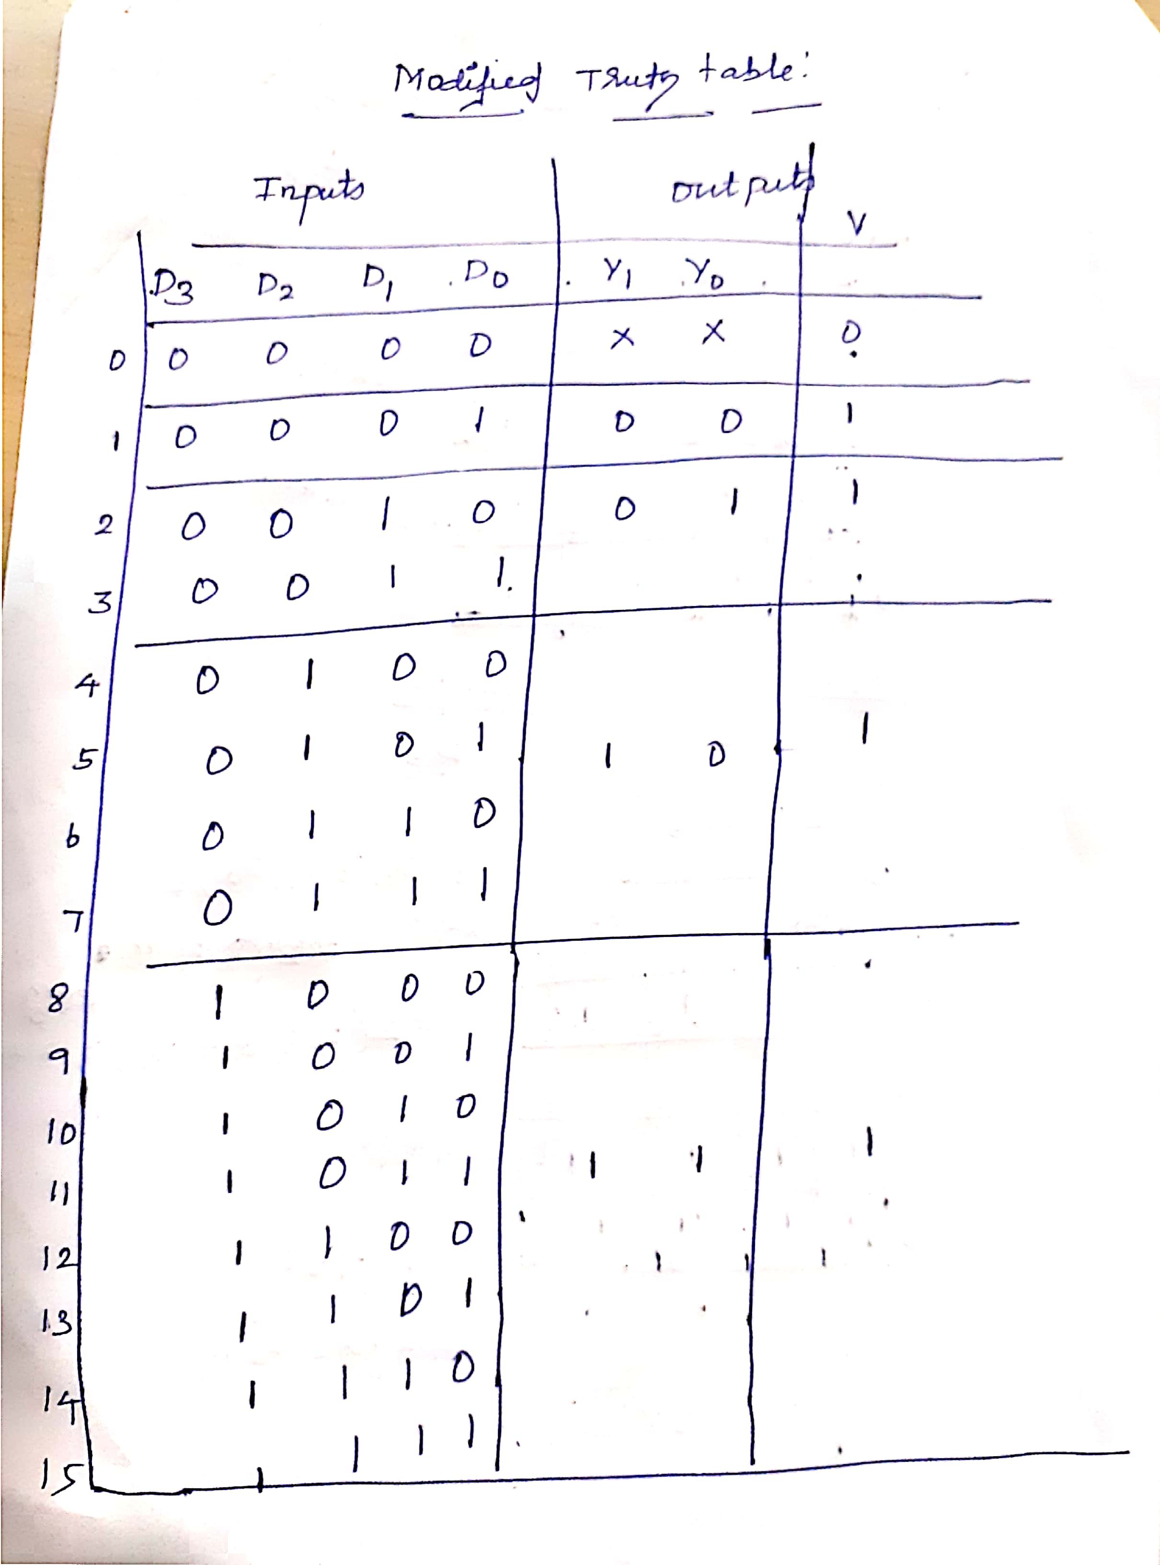

Slide 26
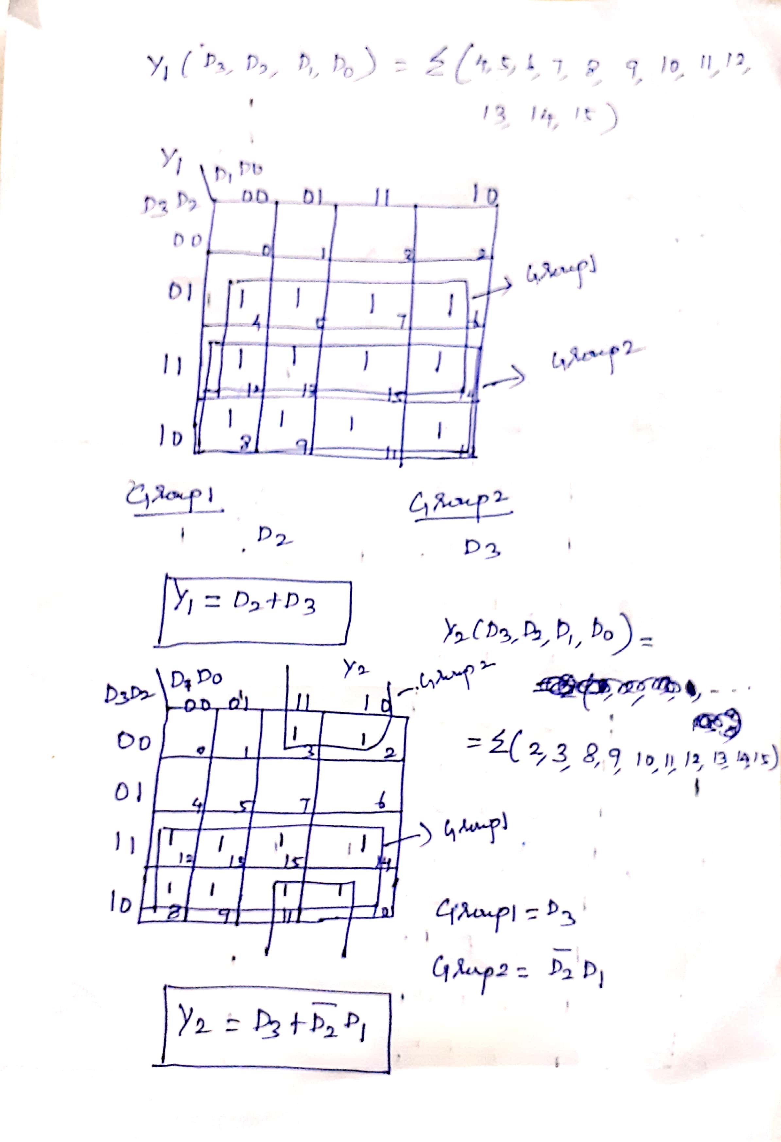

Slide 27
LOGIC DIAGRAM OF PRIORITY ENCODER:
Y₁ = D₂ + D₃
Y₀ = D₃ + D₂ D₁
D₃ D₂ D₁ D₀
Y₁
Y₀
Fig. 17

